Slide 1
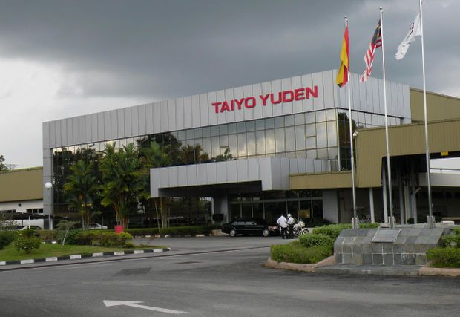



TAIYO YUDEN (SARAWAK) SDN BHD
Prepared By : ALVIN ANAK SAMAIL

Slide 2


TABLE OF CONTENTS
Introduction
Aim & Objectives of Industrial Training
Company Profile & Background
Training Scopes
Work Experiences
Project Sketching
Project Timeline
SWOT Analysis
Recommendation
Conclusion

Slide 3

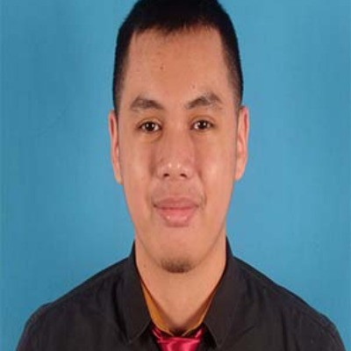
INTRODUCTION
ALVIN ANAK SAMAIL
Title : UNDERGRADUATE SOFTWARE ENGINEER
Abut me
Position : INTERN STUDENT
Work Experience
Hello everyone my name is Alvin anak Samail an Intern Student from Taiyo Yuden Sarawak .
Skill
2023-Present - Data team management and system developer at Taiyo Yuden Sarawak Sdn Bhd
To develop a mobile and web aplication.
Design and build a project of the system.
Maintenance and testing the system software.
Programming skill : C++, C, Python, PHP, HTML, Java, XML, Javascript.
Education History
2018-2019 - Matriculation Programme
2019-Present - UNIMAS

Slide 4
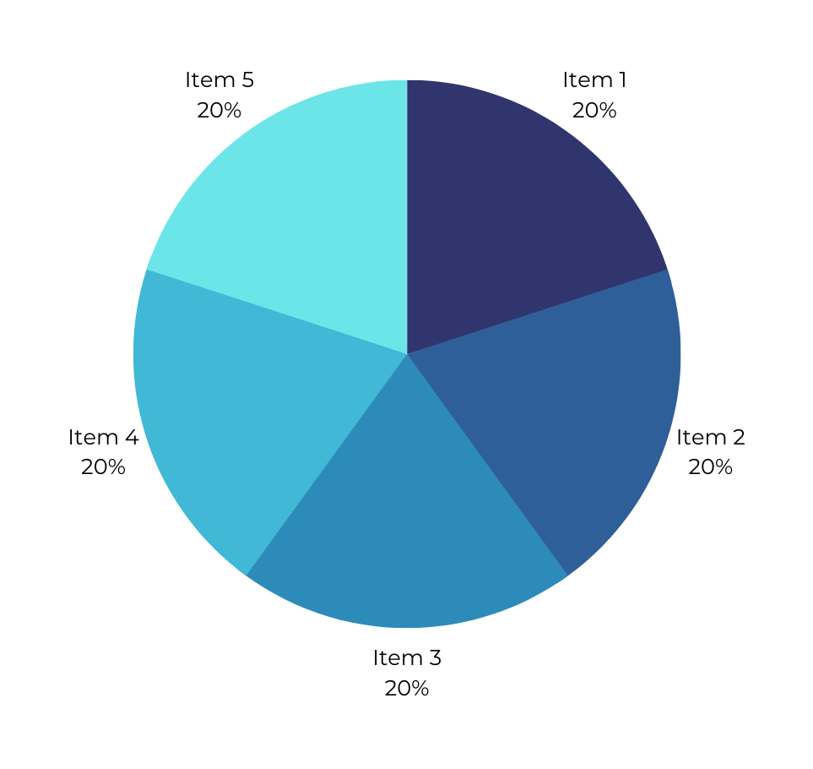

Imrpove Understanding
Improve Communication
AIM & OBJECTIVES OF IT
The Industrial Training is aiming for helping student to increase and overcome their self confident on their abilties and skill in the working area.
The objective of industrial training is to give a cahange for student to recognize the real working environment and to increase the ability of graduates to work.
Improve Deceplines
Improve Skill
Improve problem Solving

Slide 5
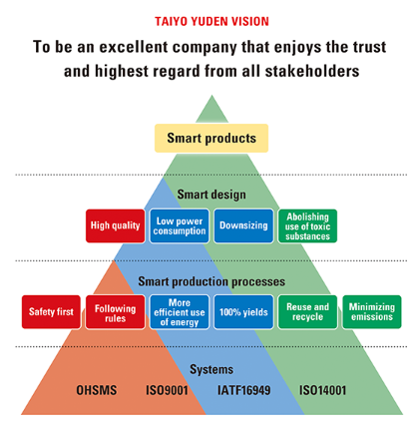
COMPANY PROFILE
Mission
Philosophy
Stronger and more socially aware through
the wonders of science
Employee well-being
Betterment of local communities
Responsibility to provide returns to shareholders
Vision
Goals
To be an excellent company that enjoys the trust
and highest regard from all stakeholders
Ultimately for contribution to biodiversity conservation.

Slide 6



The Product
Capacitors
Taiyo Yuden Co., Ltd. (太陽誘電株式会社, Taiyō Yūden Kabushiki-gaisha, translated as Sun Dielectric Co., Ltd.) is a Japanese materials and electronics company
COMPANY BACKGROUND
Taiyo Yuden was established by Hikohachi Sato on March 23, 1950, in Suginami, Tokyo.
Geographical Location
Taiyo Yuden (Malaysia) SDN. BHD.
Taiyo Yuden (Sarawak) Sdn. Bhd..

Slide 7

TRAINING SCOPES
Training Program Overview :
Work Area :
Data Team Management
Duration : 6 month
Structure : Acomplish the new project given
How It Aligns :
Potential Contributions :
Project :
Seikei Scanning System
Insatsu Printing System
To develop a web application to manage the data of the process.
To make the company easier to record the data of the process

Slide 8
WORK EXPERIENCE
Skills Acquired
Impact
Problem Solving.
Programming.
Designing.
Data more easier to monitorize.
Work are concise follow the order.
Responsibilities
Achievements
To develop the web application based on the user requirement.
Sucessful to develop the web application which curently trial-used by process factory.

Slide 9

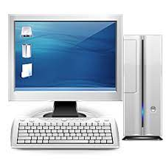

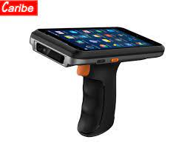
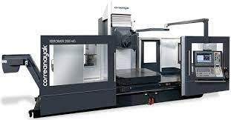



PROJECT SKETCHING
Seikei Scanning System
Insatsu Printing System
MSS Calculator System
Weighing System
Seikei Analyze System
Haigou Tokou System

Slide 10
PROJECT TIMELINE
A chart shows the project schedule and deadlines

Slide 11

SWOT
Strength : Positive customer perceptions. | Weaknesses: Outdated technology infrastructure.
Opportunities: Emerging markets with potential growth. | Threats: Aggressive competition from other companies.

Slide 12

RECOMENDATIONS
Data Backup and Recovery
Regularly back up the database to prevent data loss in case of failures.
Regular Maintenance
Regularly back up the database to prevent data loss in case of failures.
Data Modelling
Normalize the database to reduce redundancy and improve data integrity.

Slide 13
RECOMENDATIONS (CON)
Provide the Internet connection which is directly to the PC for reseach and reference.
Provide annual leave for the intern student as the employee level.
Use smart technologies to monitor data like Internet of Things (IoT) devices.

Slide 14
CONCLUSION
In conclusion, after 5 month of internship at Taiyo Yuden (Sarawak) Sdn Bhd (MSTY) as a intern student has give me opportunity to learn and show my skill in the company. The facility given by the company to me is very meaningful and very comfort in term of CSR and also other realated things. After the end of the training will looking foward to expand my skill in the company and improve my certain skill. At the end leaving greatful thanks to my supervisor from Taiyo Yuden Miss Esther and also other supervisor that has guide me through the training.

Slide 15

THANK YOU
Special thanks to..

